Slide 1
Gaining Cultural Awareness Through Online Newspapers & Literature
Michael Cartmill, Ph.D.
300th MI Brigade
Annual Language Conference March 2016

Slide 4
MOS DD214
DFAC APO
BCT AIT
APFT

Slide 5
Speaking The Culture
Culture and language are
INSEPARABLY
linked

Slide 6
ONLINE NEWSPAPERS/LITERATURE
Big “C” culture
Pop culture—media, sports, humor, etc.
Current events of importance
Disposition of area of interest
New vocabulary, correct grammar

Slide 7
Big “C” culture:
Art
Literature
Music
History/mythology
architecture

Slide 8
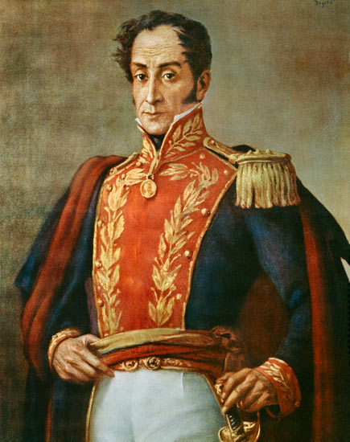
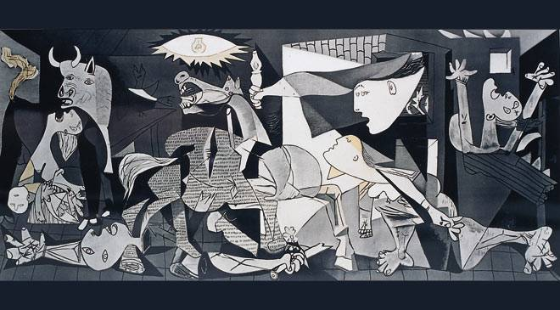
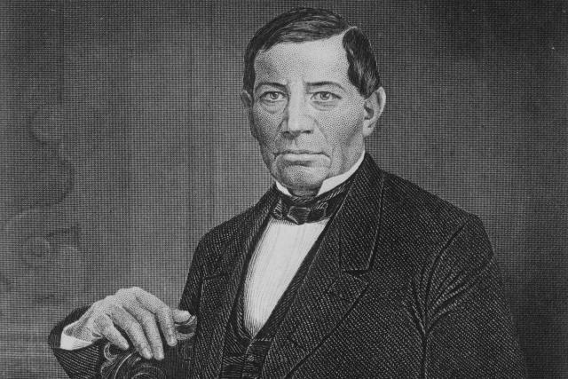
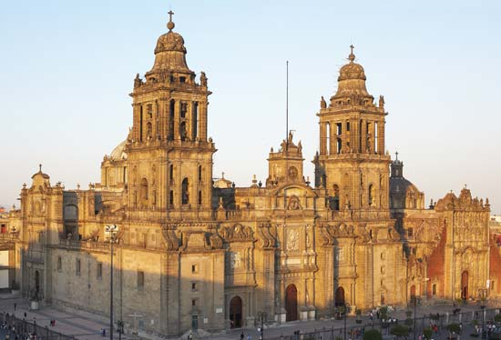

Slide 9
Pop culture:
Movies/tv/Music
Slang/idioms
Social media
Fashion
Sports
Politics
religion
(Anything “consumed” by public)

Slide 10
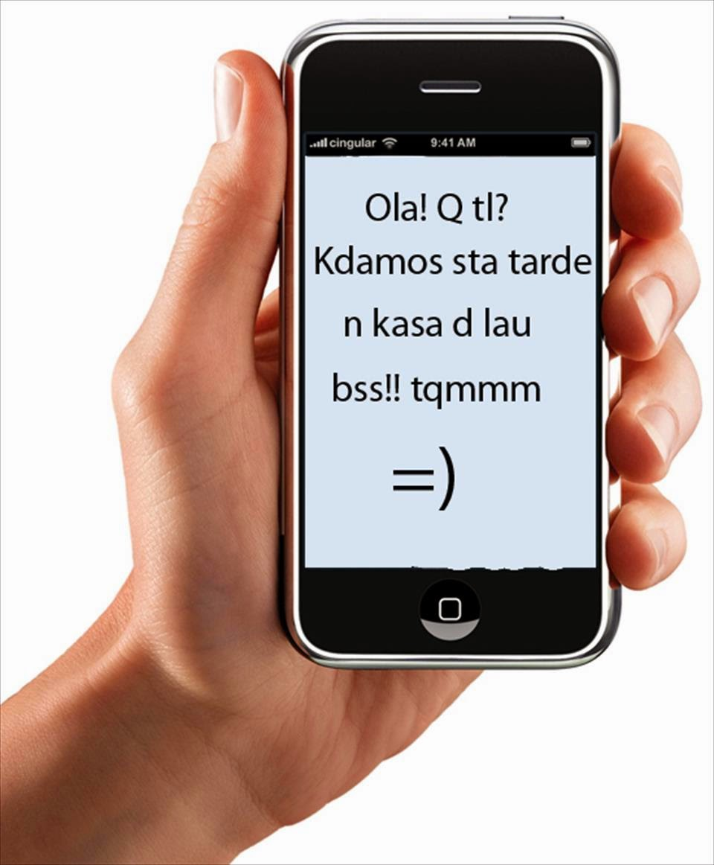
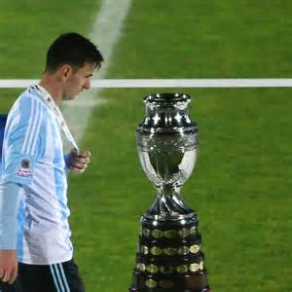
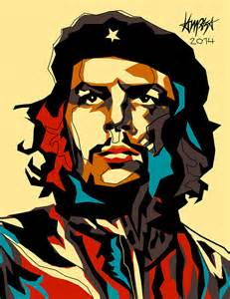
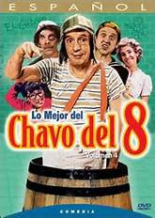

Slide 11
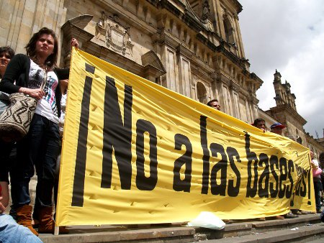
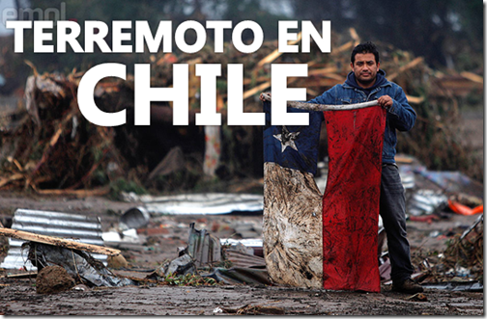
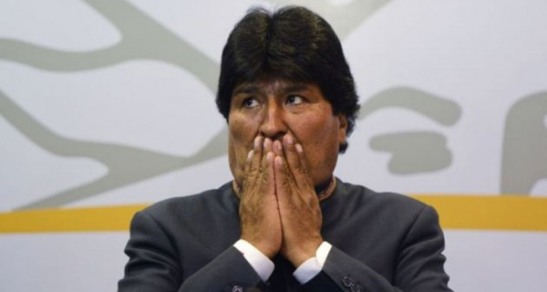
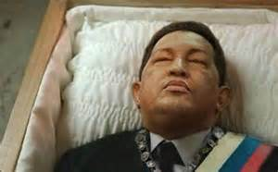
Current events/
Disposition:

Slide 12
Using Websites to study, retain, acquire Culture:
LANIC
Donquijote.org
España al desnudo
GoodReads

Slide 13
AVOID Translations!
-- poor structure
-- can lack target culture
-- things do get “lost”

Slide 14
QUESTIONS?

Slide 15
References:
LANIC-- http://lanic.utexas.edu
http://donquijote.org
http://bing.com/images
Picasso’s Guernica--http://www.xn--espaaescultura-tnb.es/es/estilos_artisticos/vanguardias.html
García Márquez--http://goodreads.com
Catedral metropolitan--http://www.britannica.com/
http://www.Incas.info
http://Latinamericanhistory.about.com
http://www.taringa.net
http://Cafesempo.com.br
http://deportes.terra.com
http://www.emol.com
http://www.radioguaimaro.icrt.cu
http://www.filmaffinity.com
http://www.mexicoxport.com
http://desdeelvip.blogspot.com
https://tonyseed.wordpress.com
España al desnudo-- http://ibgwww.colorado.edu/~gayan/spain.html
http://www.laguarimba.org

