Slide 1

Summits
on the Air
By Mike Cartmill
ACØPR

Slide 2
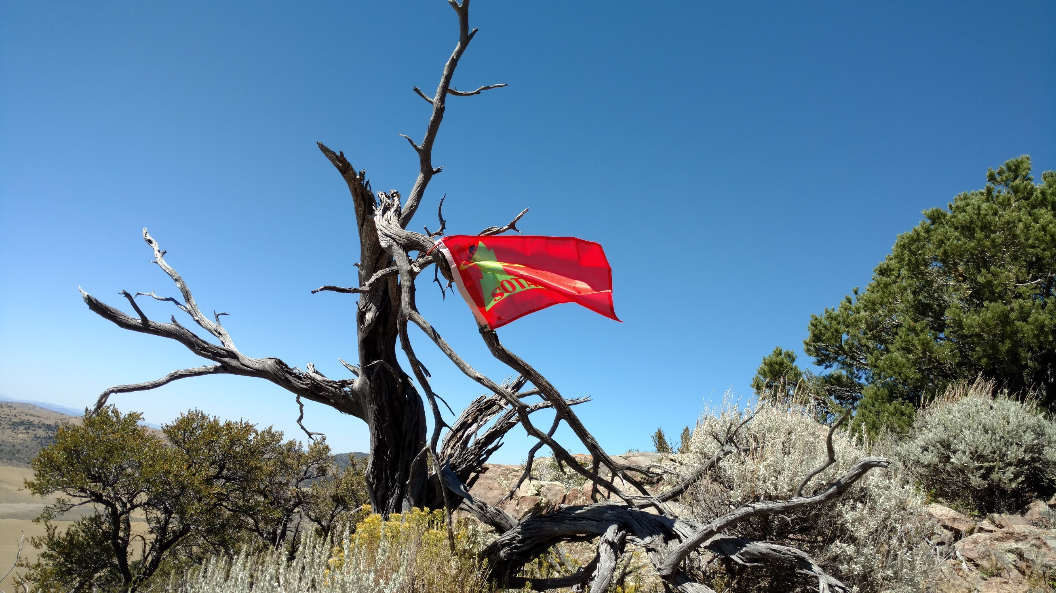
W7U/WS-016 (7660) near Pine Valley

Slide 3
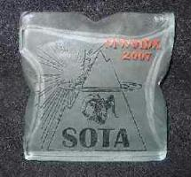
ACTIVATORS—hike/climb summits carrying their gear and make contacts. (Each Summit Once/yr.)
Chasers—contact the activators. (Each Summit once/day UTC)
Each earn points towards awards:
1,000 points (MOUNTAIN GOAT)
1,000 points (SHACK SLOTH)

Slide 4
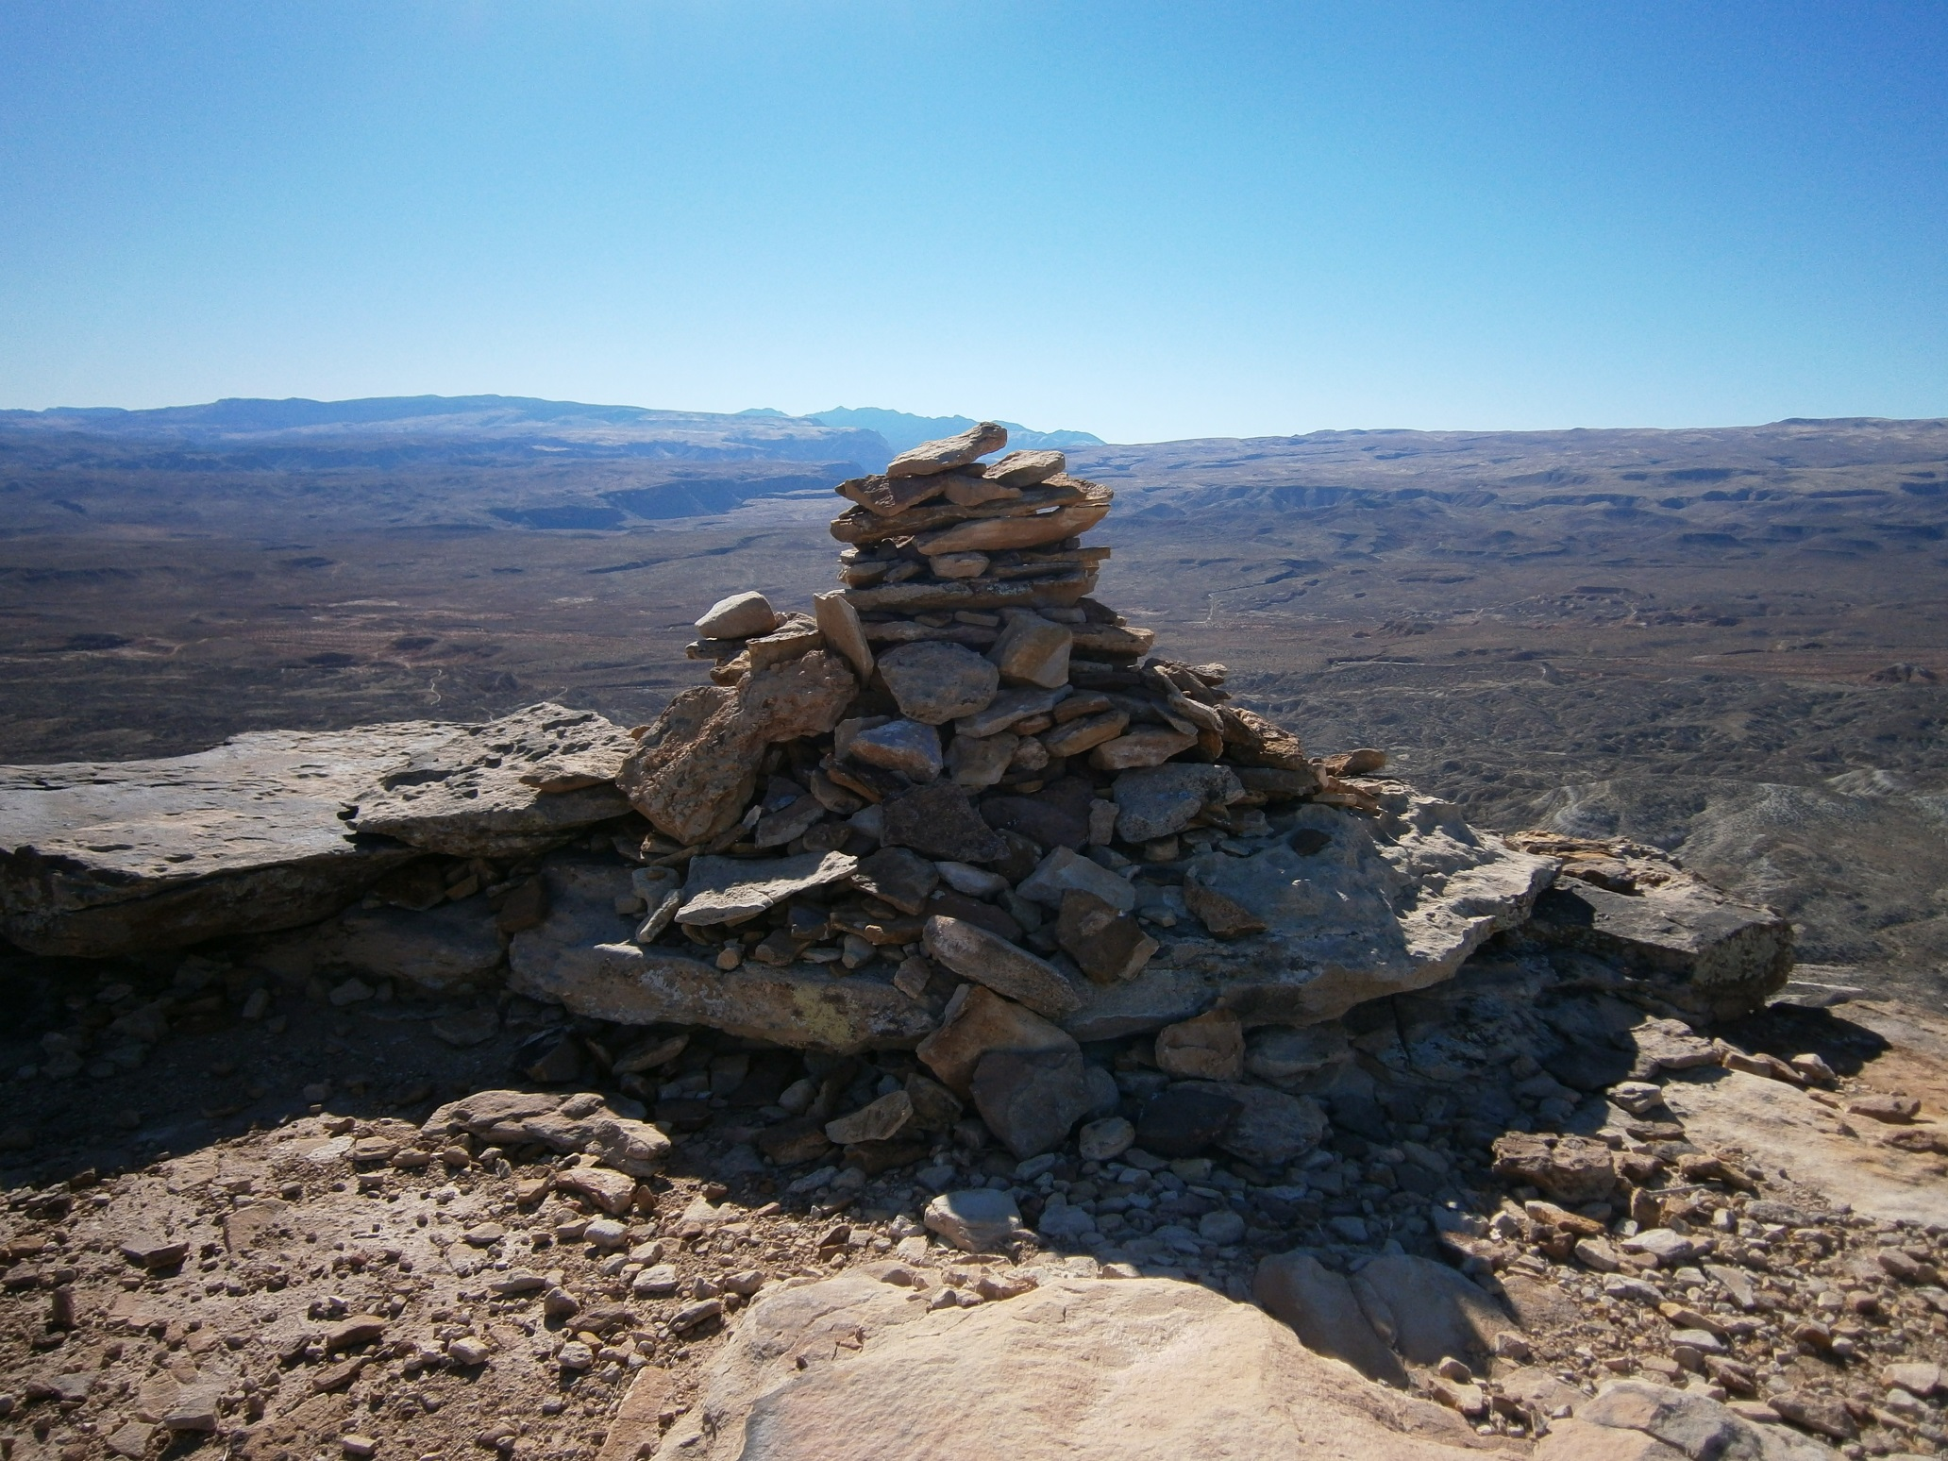
Bloomington Hill

Slide 5
SOTA started in England in 2002
Now 109 Associations
Utah is W7U (July 1, 2010)
31 regions, 1577 Summits
Ex: W7U/WS-005 (Kolob Peak)

Slide 6
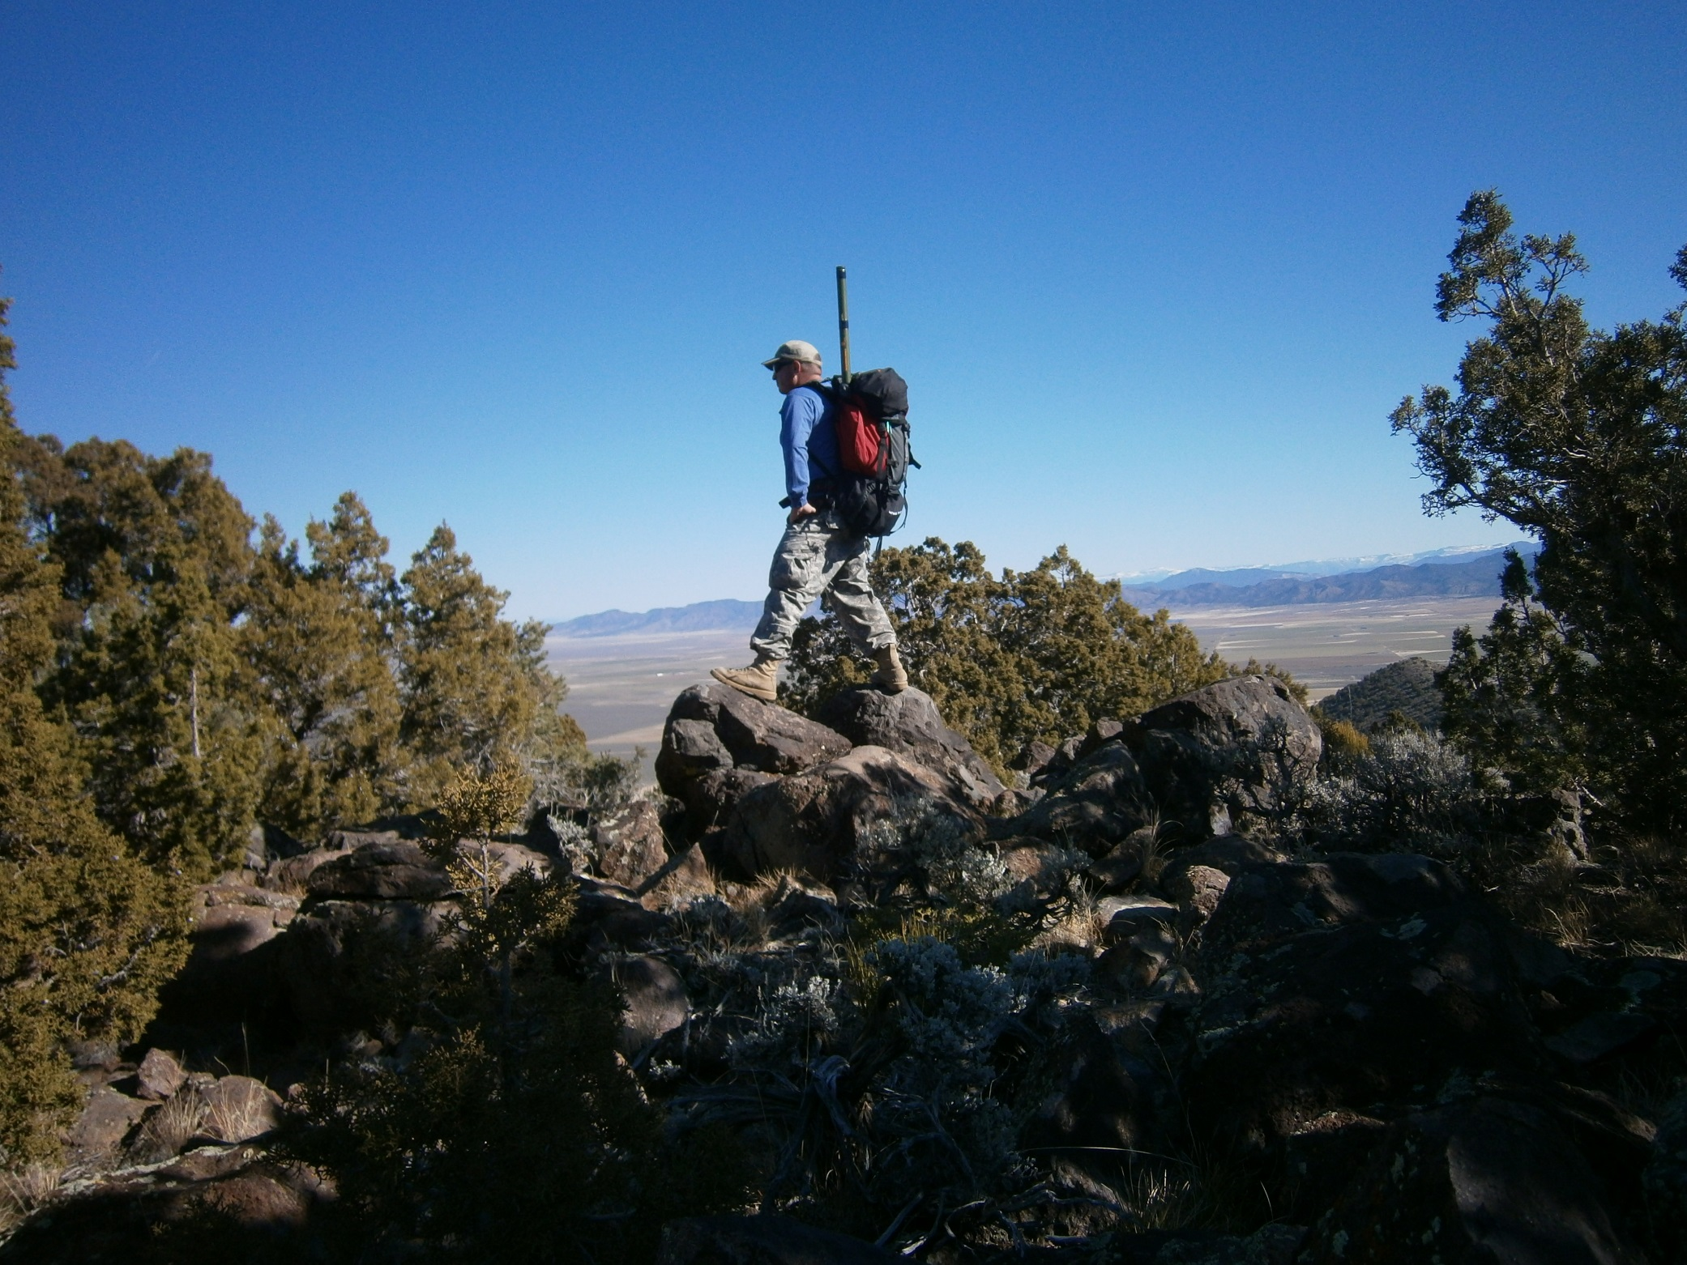
W7U/IR-052 (6422) NW of Enterprise

Slide 7
Summit Points are determined by altitude, not difficulty!
Utah Points Peak Count
Band 1, score 1 point < 5500 ft 94
Band 2, score 2 points >=5500 ft asl <6500 ft asl 279
Band 3, score 4 points >=6500 ft asl <7500 ft asl 409
Band 4, score 6 points >=7500 ft asl <9000 ft asl 379
Band 5, score 8 points >=9000 ft asl <10500 ft asl 235
Band 6, score 10 pts >=10500 ft asl 179
Total No. Peaks: 1574
Seasonal Bonus! 3 points (Dec. 1-Mar. 31) over 6500 ft

Slide 8
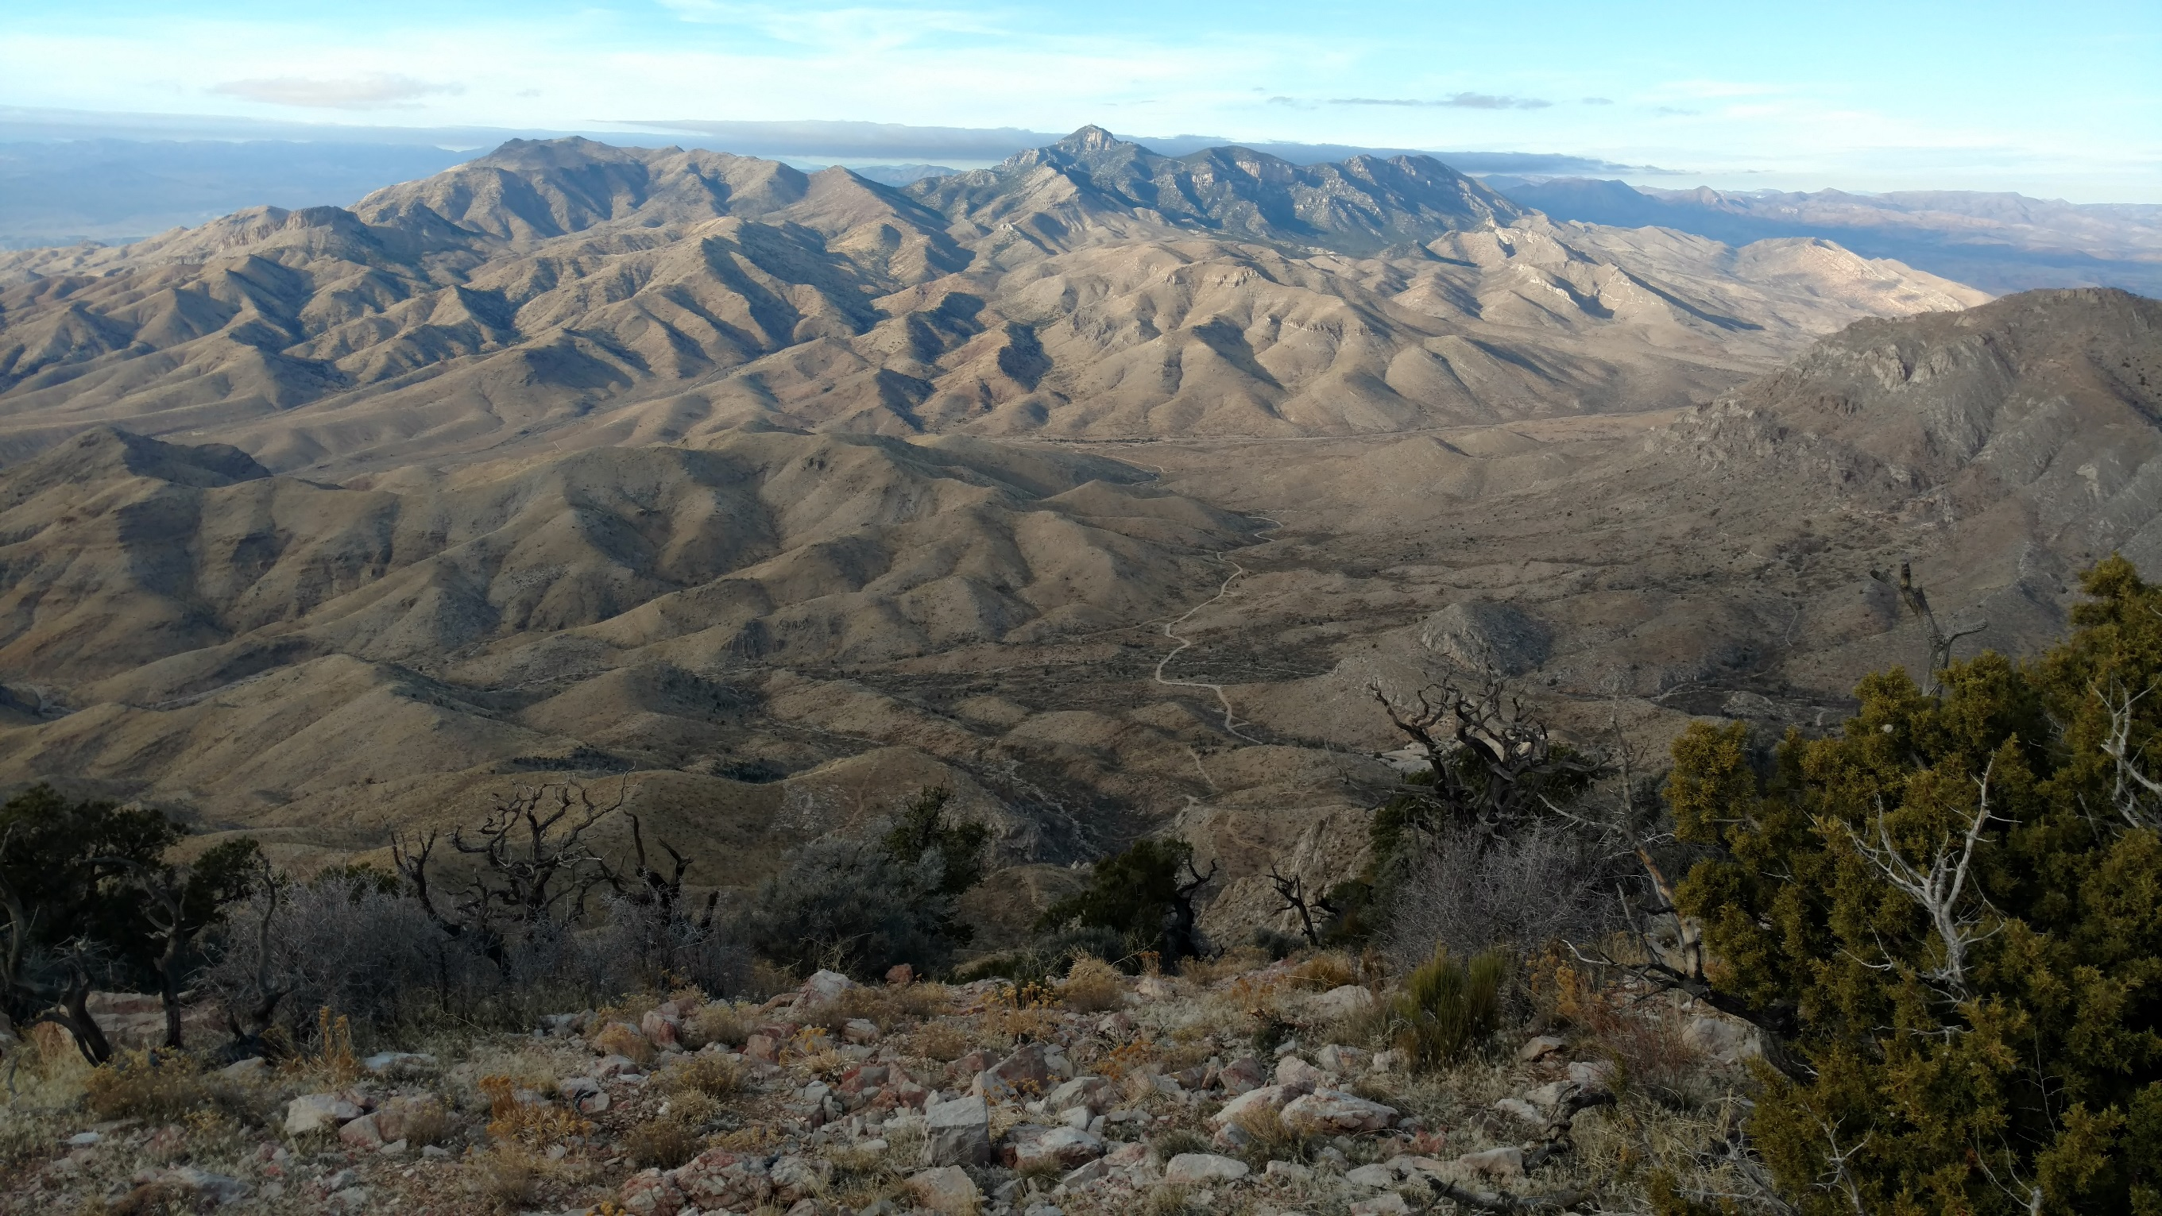
Scrub Benchmark

Slide 9
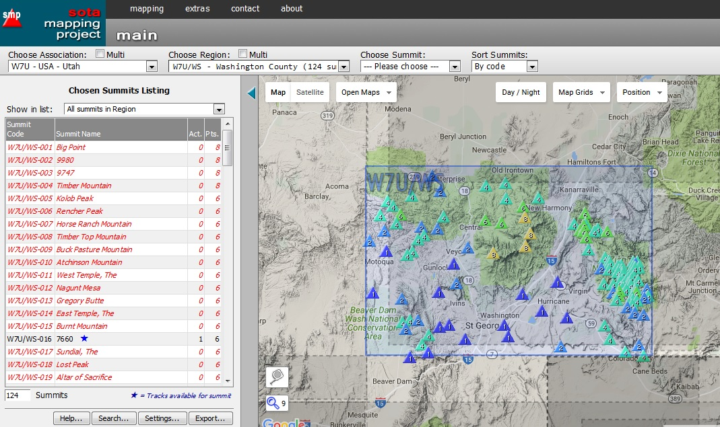

Slide 10
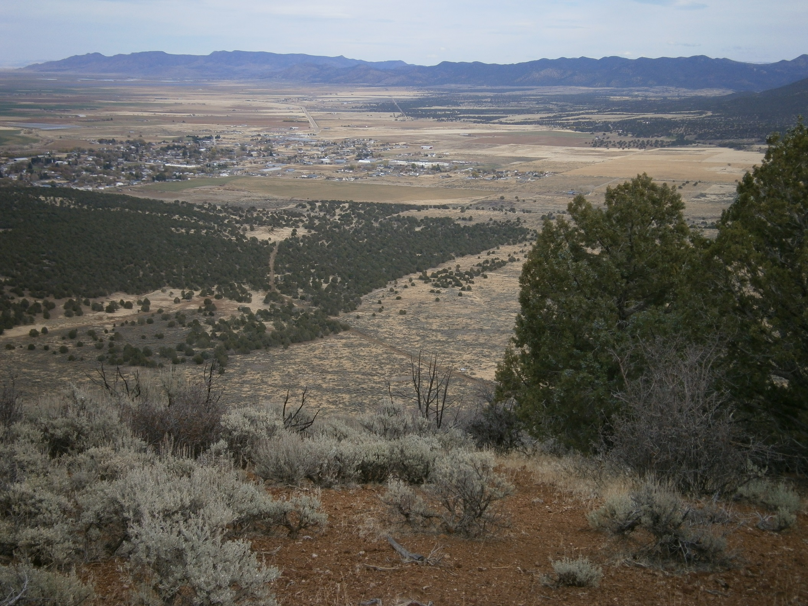
“E” Mountain overlooking Enterprise

Slide 11
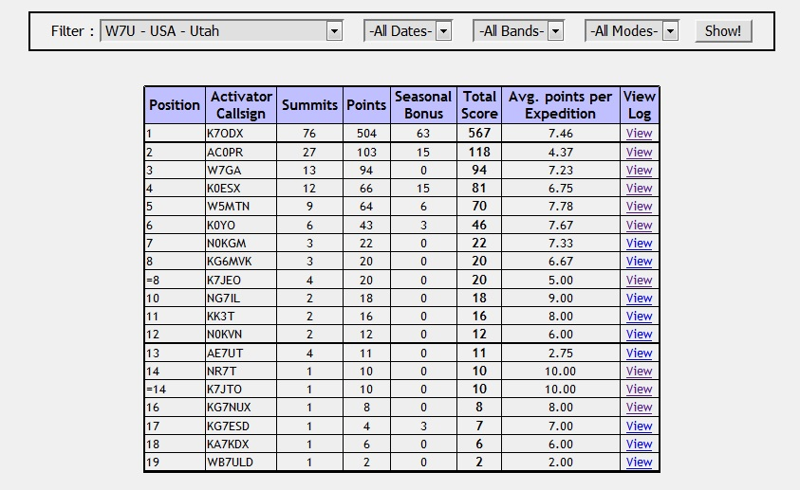
Keep track of your progress online

Slide 12
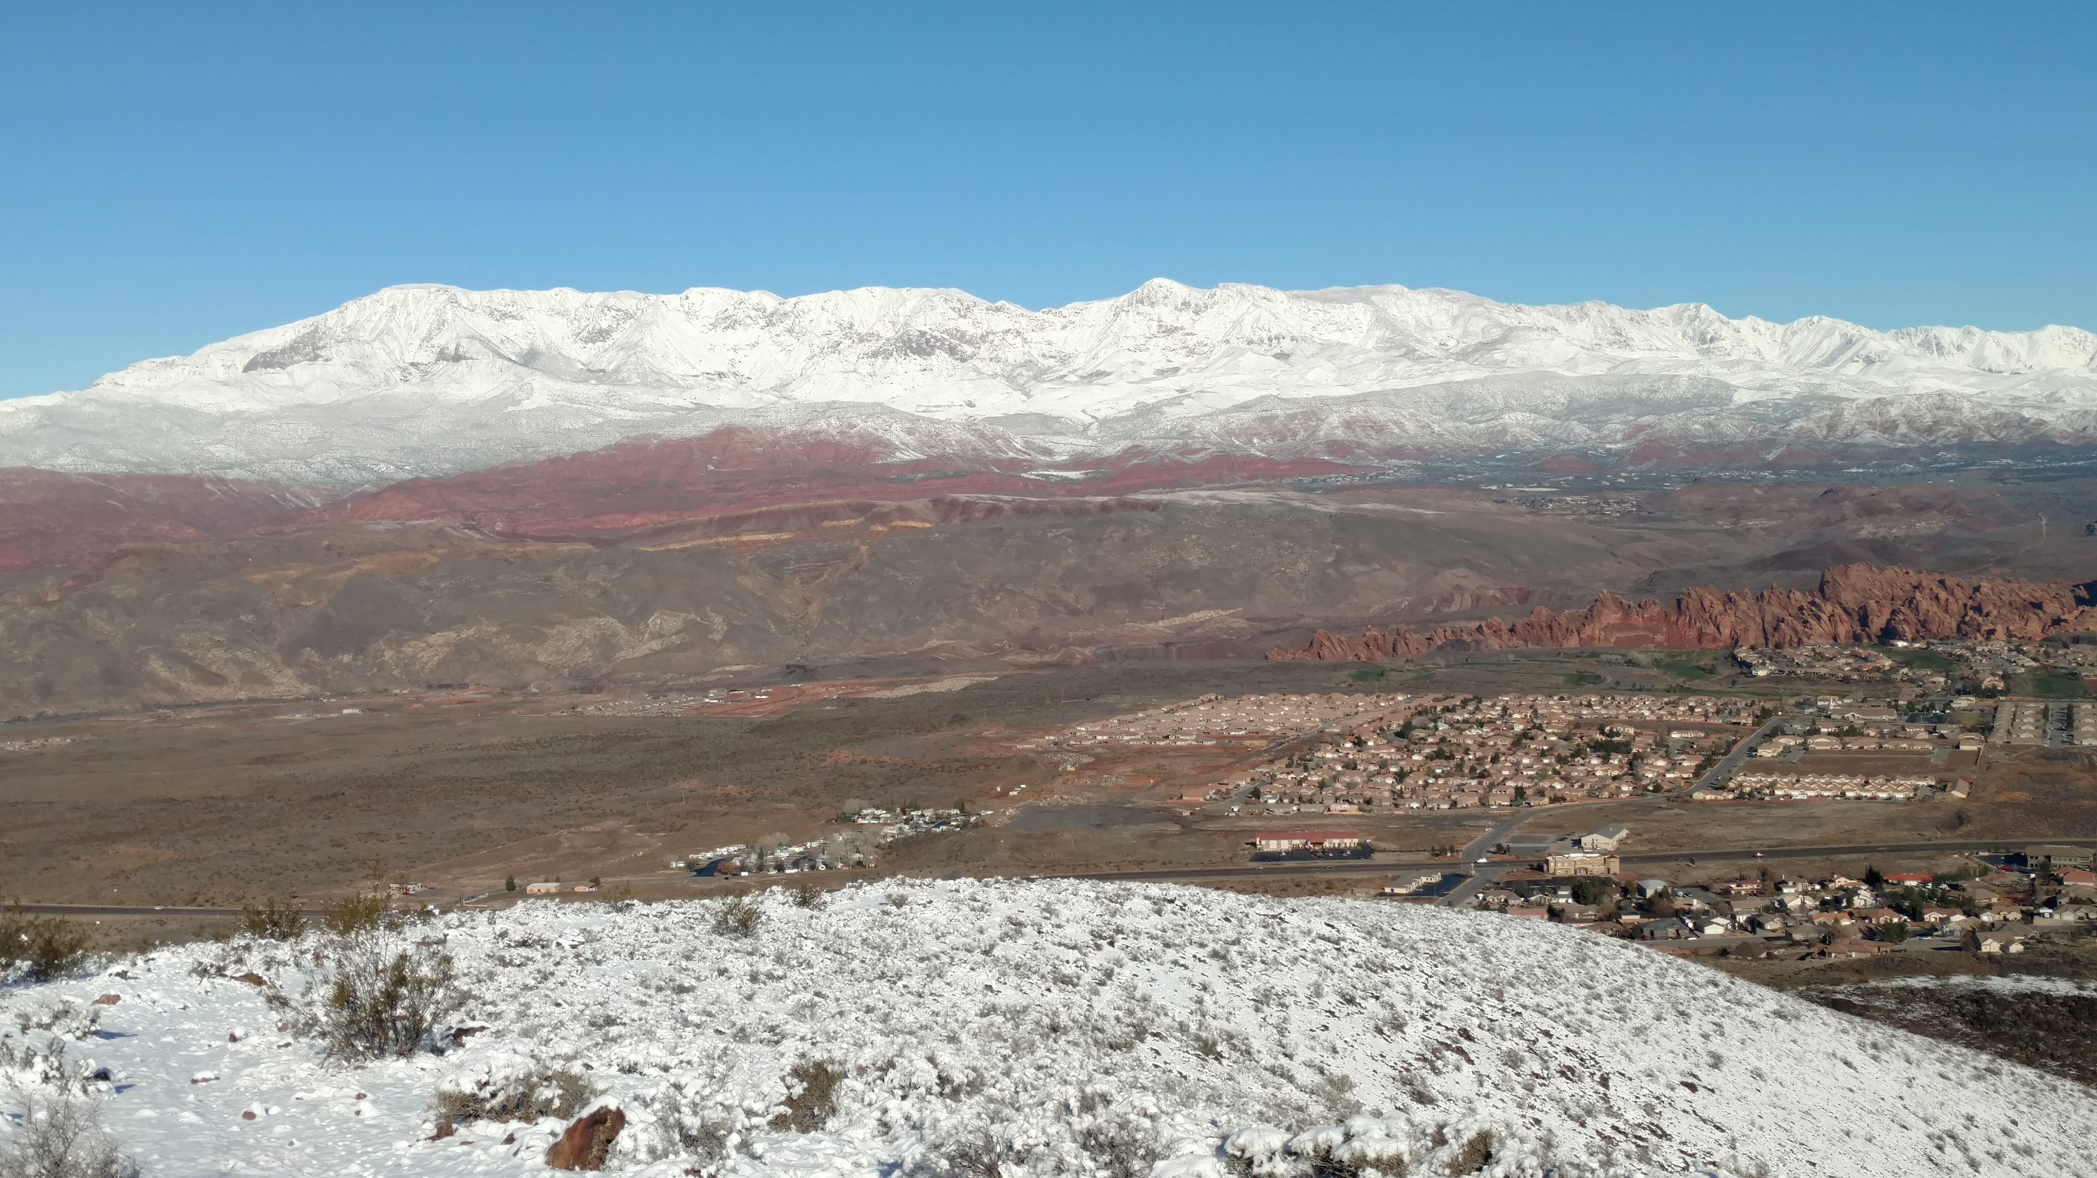
View from Sullivan Knoll

Slide 13
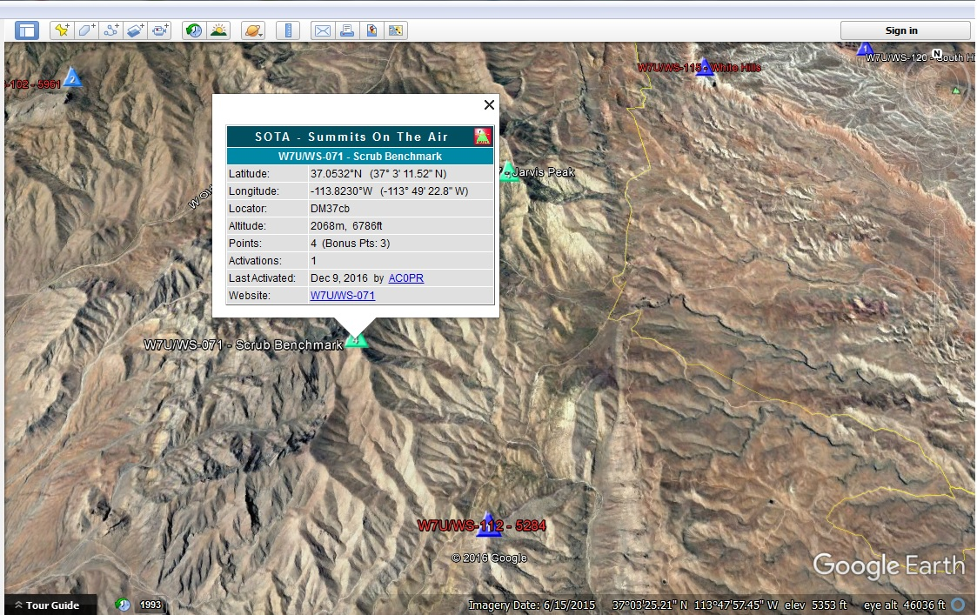
Files can be downloaded to
Google
Earth

Slide 14
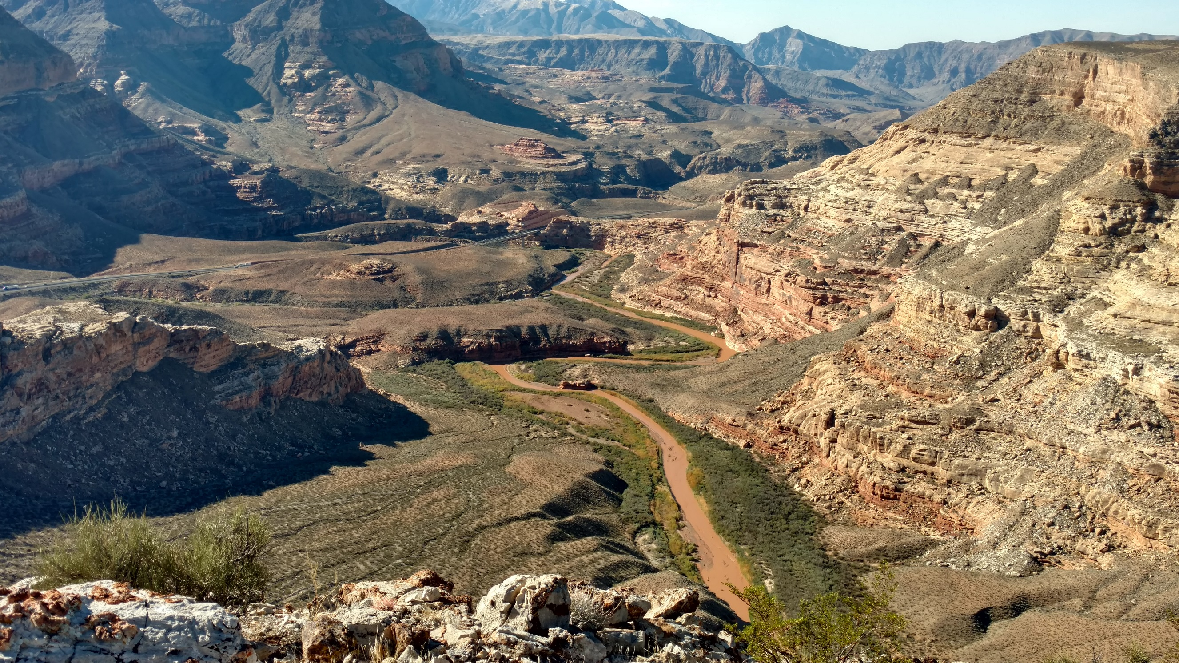
Starvation Point, AZ

Slide 15

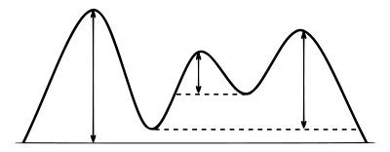

Prominence—must have 500 feet
to qualify
1000
800
600
250
700
0

Slide 16
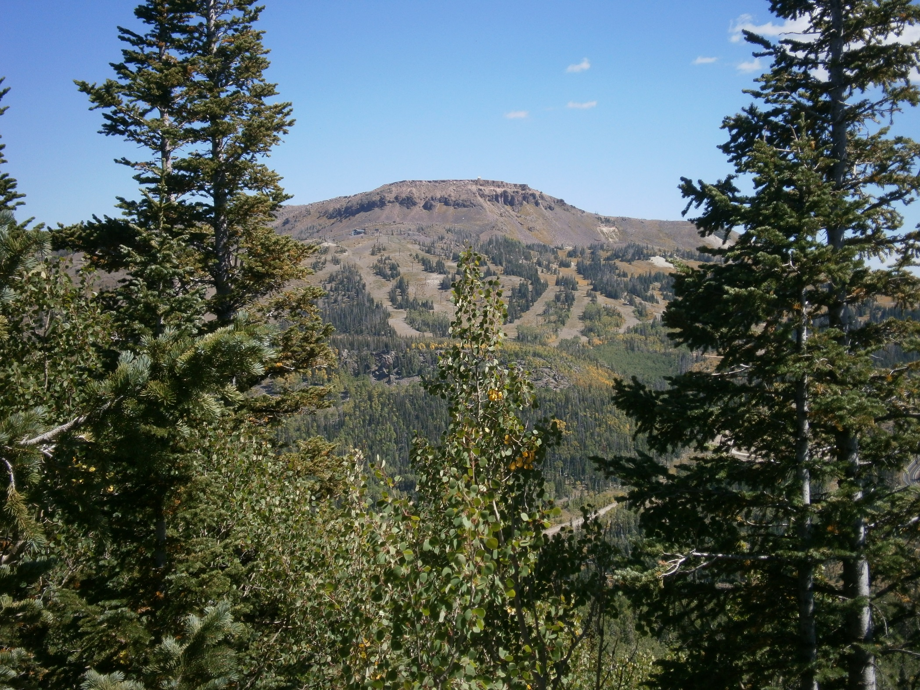
Brian Head (from Navajo Point)

Slide 17
Some guidelines:
Reach the summit by non-motorized power—Prohibited activating from vehicles
Must activate with the “activation zone” an “unbroken” area contoured 80 feet below the summit
Must obey all laws and property rights
4 Qso’s required to receive points
You are responsible for your own safety

Slide 18
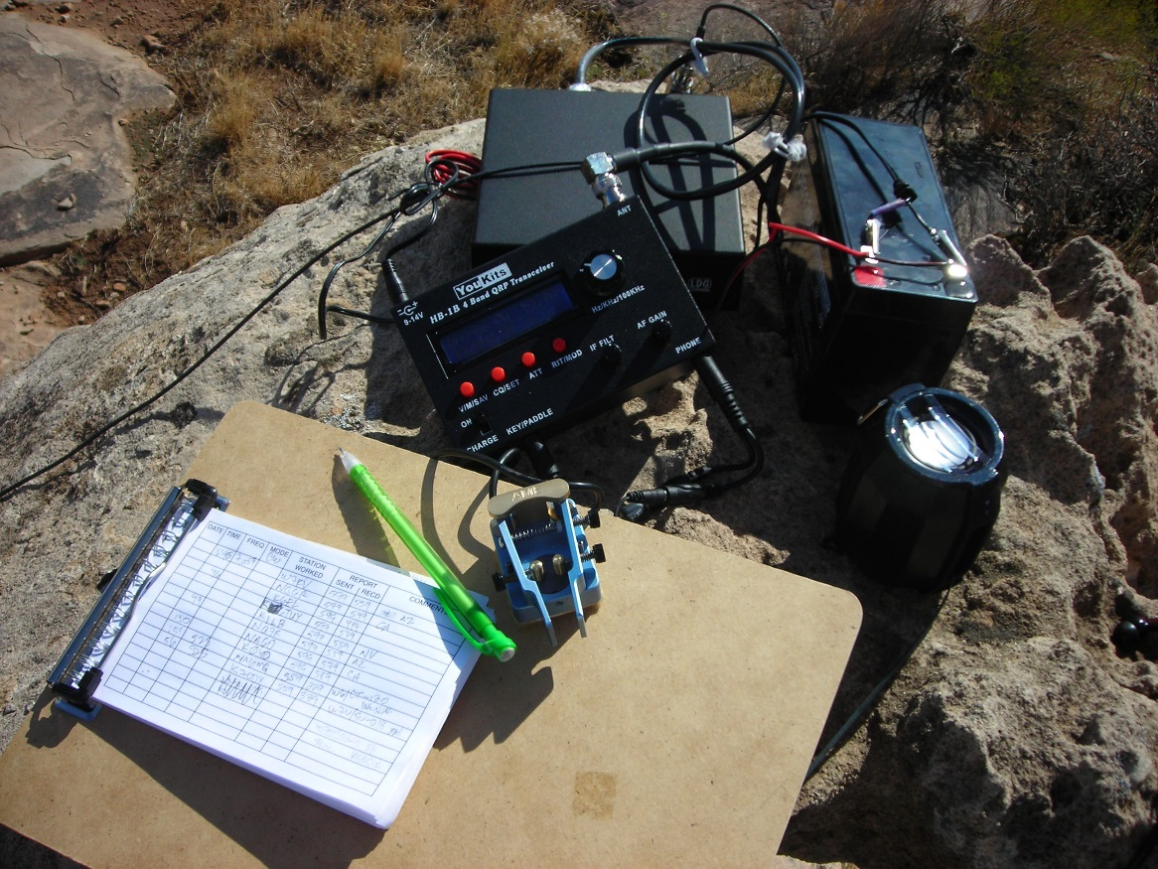
SOTA gear at Shinob Kibe

Slide 19
SAFETY!
Know your own abilities and limitations!
Carry the necessary gear for weather changes
Many summits have no trails
Just because a summit is listed does NOT mean it is reachable, safe, or accessible!
DON’T be afraid to cancel and turn around.

Slide 20
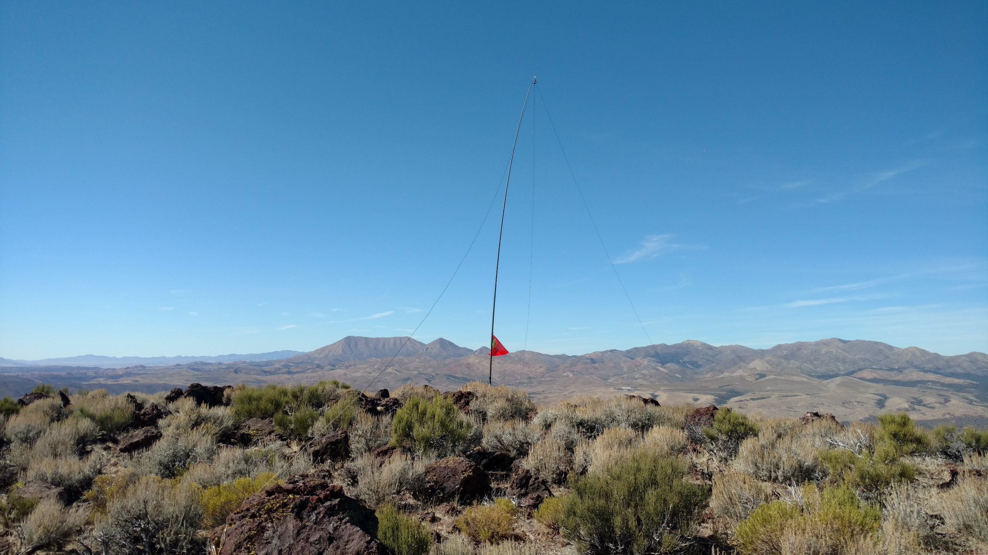
Veyo Volcano

Slide 21
ACTIVATING! A few suggestions:
Most popular modes are SSB, CW, and FM (2Meter)—test your gear before you go!
Do as much research and recon before you go (Google Earth, trip reports, topo maps, etc)
Give yourself PLENTY of time
Start with easier summits first
Have a backup plan!
While taking essentials, keep your pack light!

Slide 22
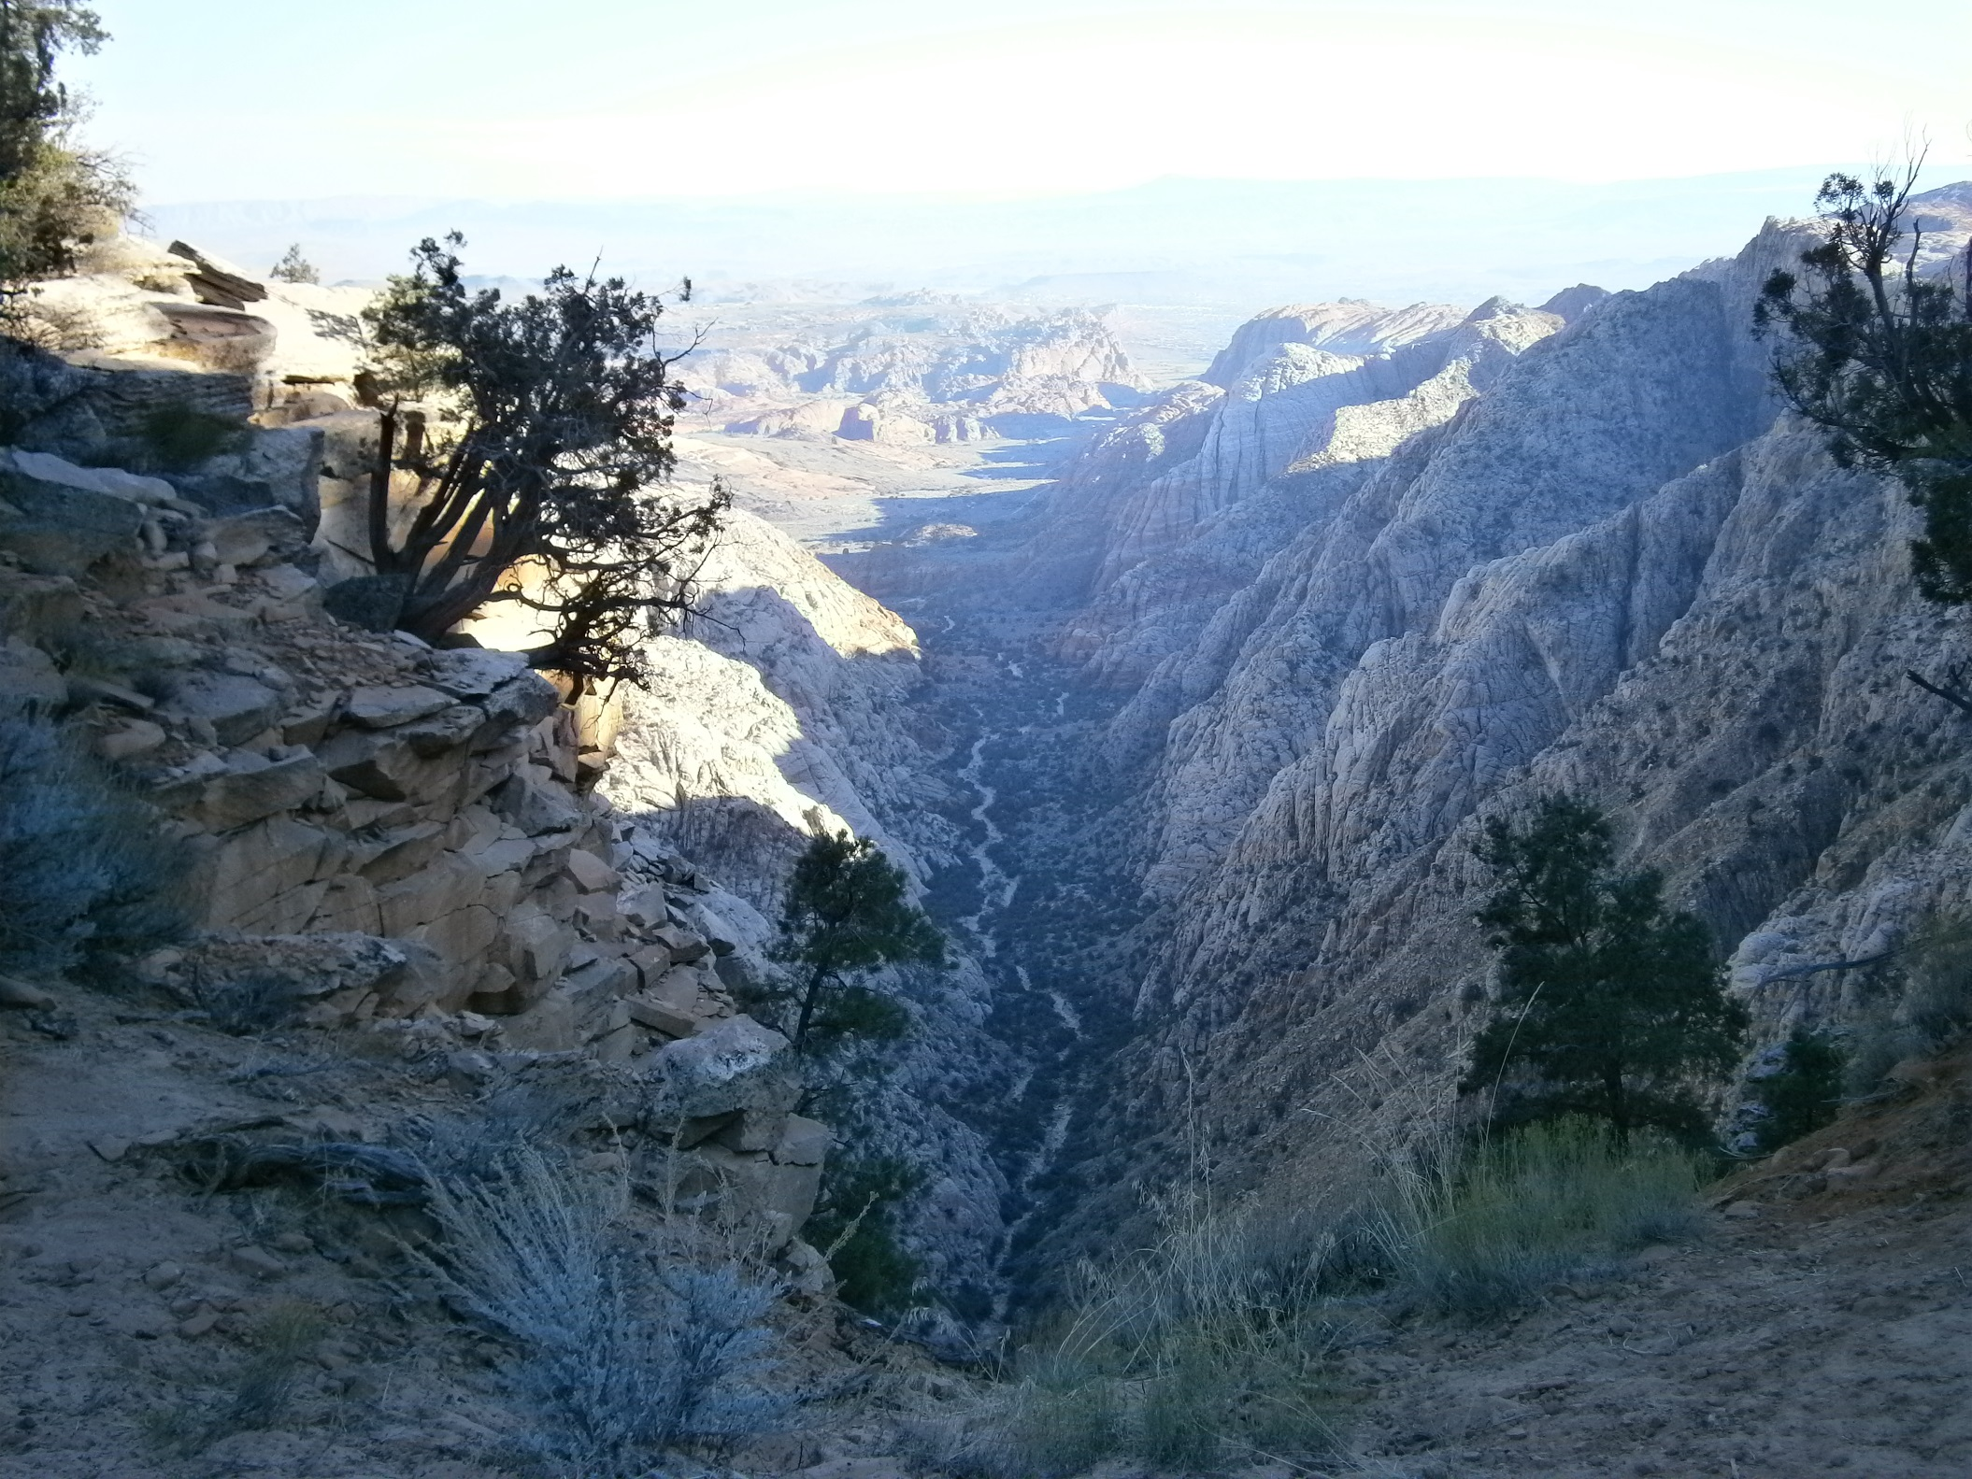
En route to
Snow Benchmark

Slide 23
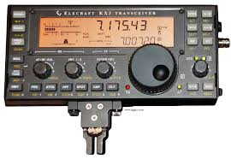
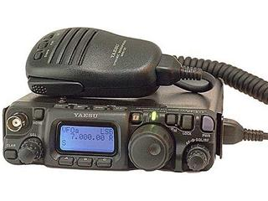
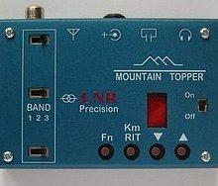
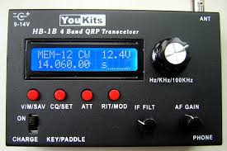

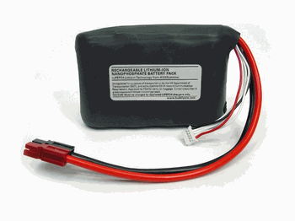
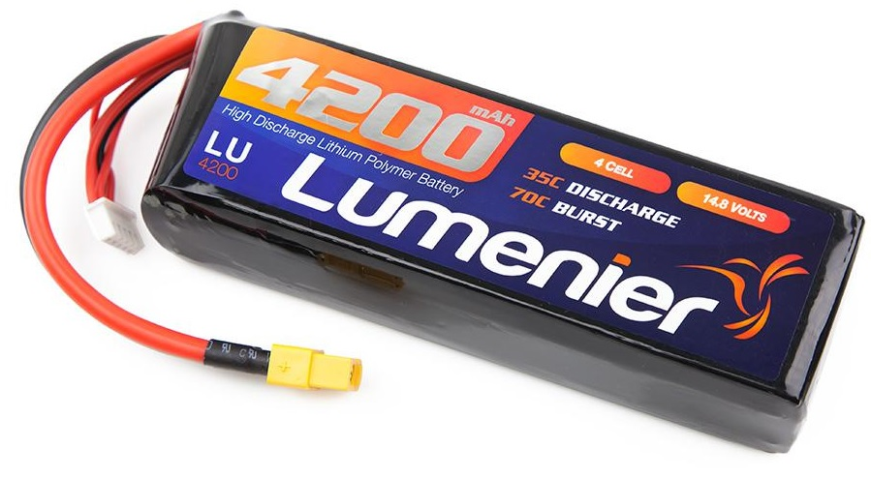
Equipment:
Radios: Elecraft KX3, Yaesu FT-817, LNR Mountain Topper, Youkits HB-1B for HF; numerous options for VHF
Antennas: EFHW (end-fed-half-wave) wire, OCF (off-center-fed) dipole, Buddipole or similar, linked dipoles, vertical wire; Yagi for VHF. Will you need a tuner? How will it be supported?
Battery—Think weight vs. power needs and price!
2.5 Ah
.82 lbs
$95
4.2 Ah
.86 lbs
$60
5 Ah
3.2 lbs
$16

Slide 24
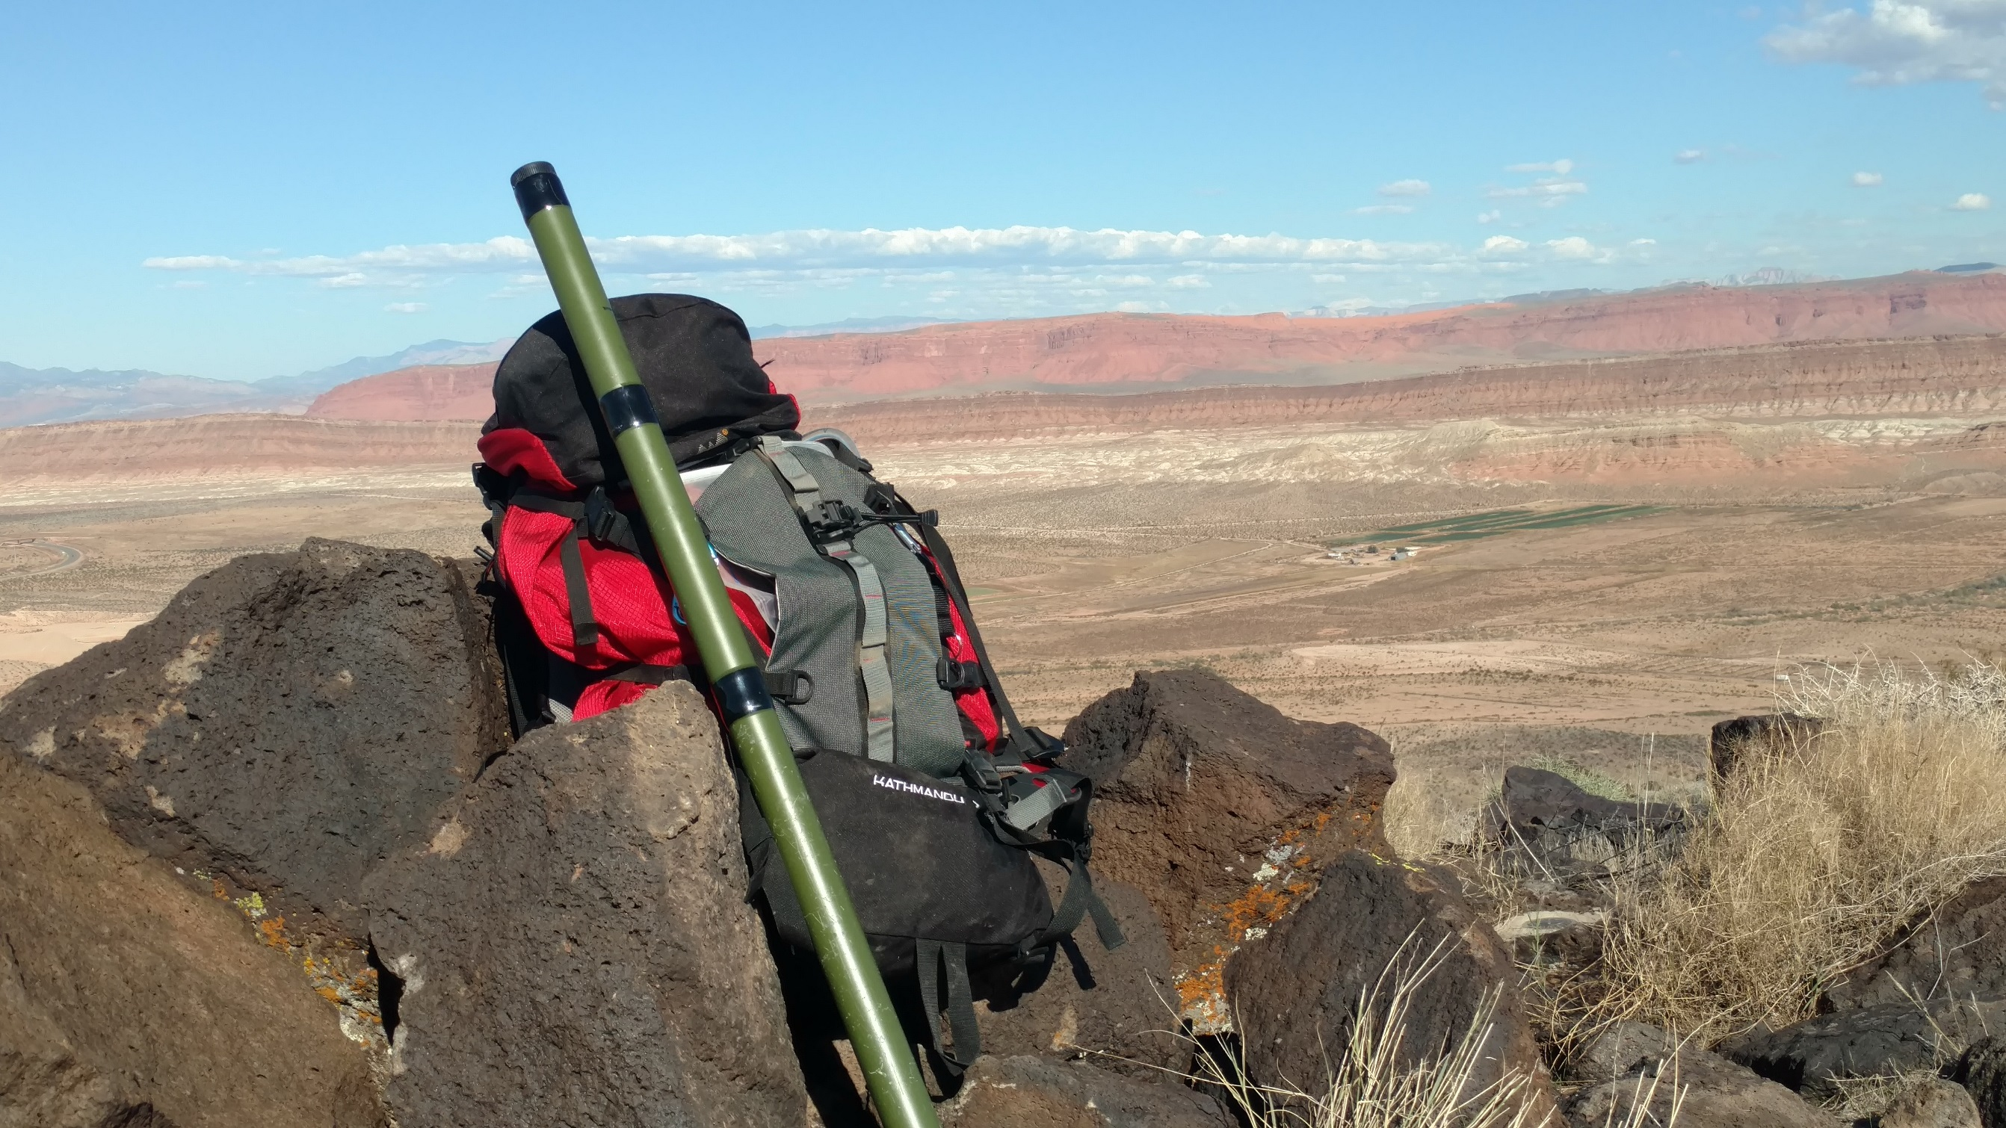
Little Black Mountain, AZ

Slide 25
Chasing:
Check spots and alerts (often activators post activations beforehand)
Can work a summit once a day (UTC time)
Don’t skip the lower-point summits, they all add up!
Please be patient and understanding (conditions on a mountain can change quickly or an activator may have other issues)
Be versatile with modes to get more points (psst…cw!)

Slide 26
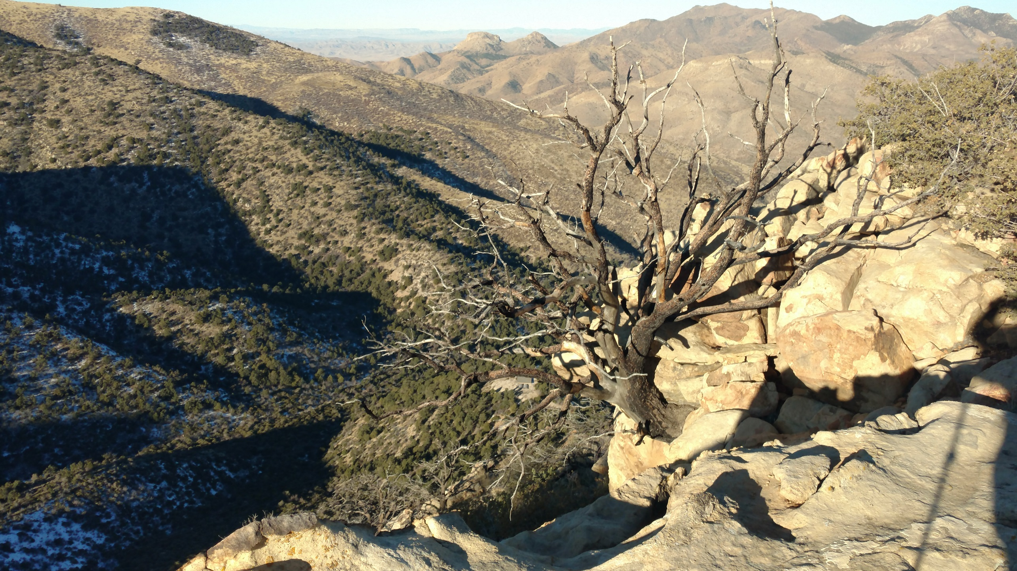
On the way up Jarvis Peak

Slide 27
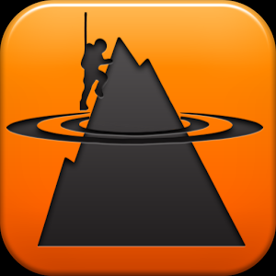

Some resources:
Mapping /Project—http://www.sotamaps.org/
SOTAwatch—http://sotawatch.org
SOTA database—www.sotadata.org.uk/
SOTA main page (also ARM)—www.sota.org.uk/
Apps
    Sota Spotter Sota Finder Sota Goat
I have videos posted on my website of activations

Slide 28
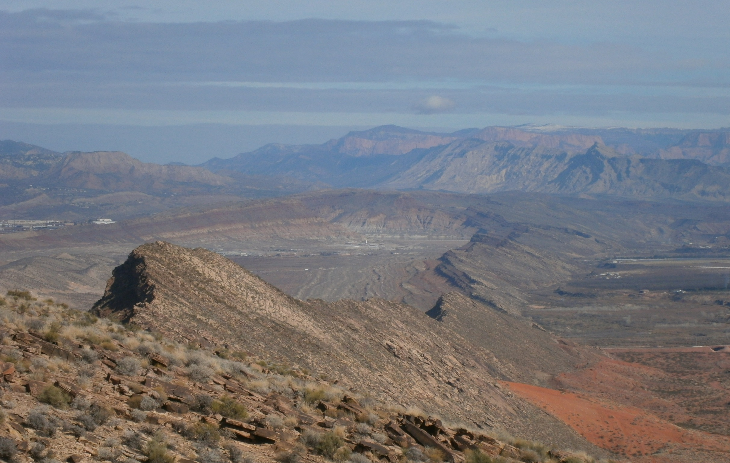
Punchbowl Dome

Slide 29
QUESTIONS?

